Slide 1

Introductory Statistics
Introductory Statistics

Slide 2
Inference for Two Means: Paired Data
Intro to Matched Pairs
Hypothesis Testing
Confidence Intervals
Checking Requirements

Slide 3
Paired or Dependent Samples
Paired or Dependent Samples – Individuals in one sample are used to determine the units or individuals to be in the second sample
e.g., are sons taller than dads?
The second sample is dependent on how the first sample is selected.
Either two units can be paired together or two observations can be paired with one unit

Slide 4
Paired or Dependent Samples (Examples)
Either two units can be paired together or two observations can be paired with one unit
Pre-Test vs Post-Test Data
Which of Two Methods in Scouts is faster for starting fires?
Do married people have similar IQs?

Slide 5
Inference for Two Means: Paired Data
Intro to Matched Pairs
Hypothesis Testing
Confidence Intervals
Checking Requirements

Slide 6
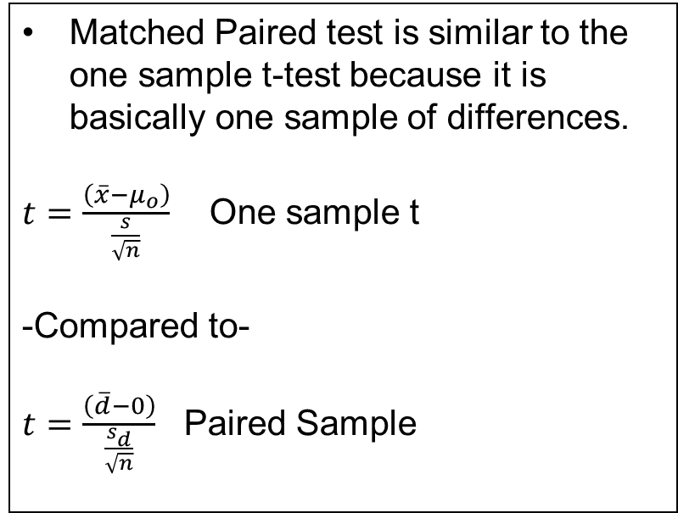
(Paired Sample) – Really a One Sample of Differences
Matched Paired test is similar to the one sample t-test because it is basically one sample of differences.
$t=\frac{\left(\overline{x}−μ_{o}\right)}{\frac{s}{\sqrt{n}}}$ One sample t
-Compared to-
$t=\frac{\left(\overline{d}−0\right)}{\frac{s_{d}}{\sqrt{n}}}$ Paired Sample

Slide 7
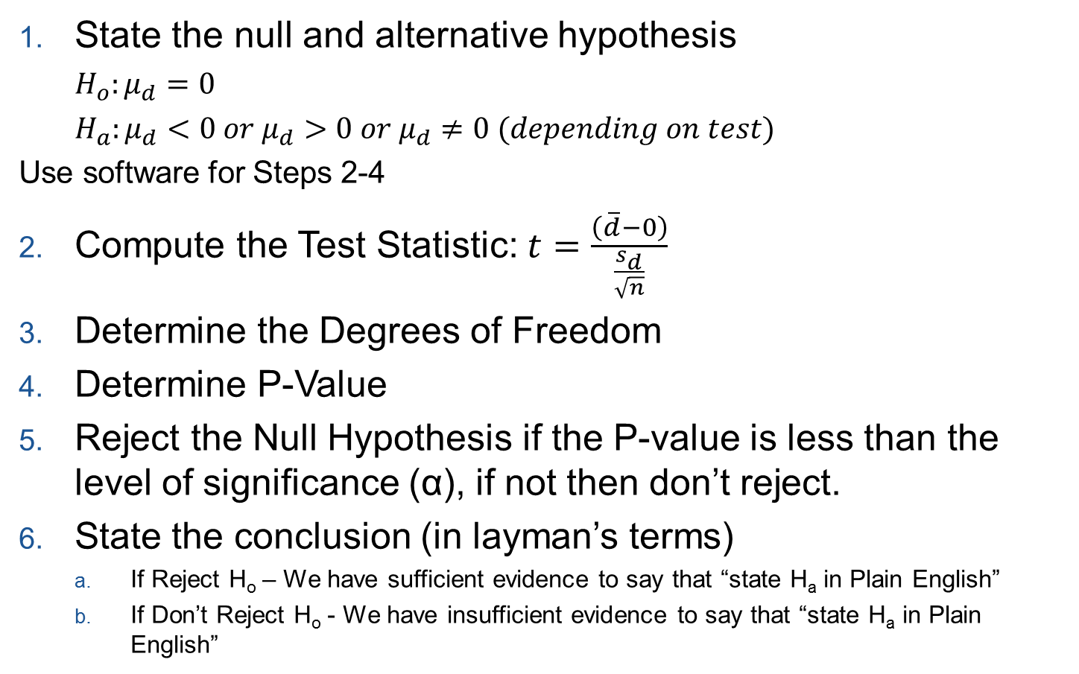
Steps to Hypothesis Testing–Matched-Pairs Design
State the null and alternative hypothesis
$H_{o}:μ_{d}=0$
$H_{a}:μ_{d}<0 or μ_{d}>0 or μ_{d}≠0 (depending on test)$
Use software for Steps 2-4
Compute the Test Statistic: $t=\frac{\left(\overline{d}−0\right)}{\frac{s_{d}}{\sqrt{n}}}$
Determine the Degrees of Freedom
Determine P-Value
Reject the Null Hypothesis if the P-value is less than the level of significance (α), if not then don’t reject.
State the conclusion (in layman’s terms)
  If Reject H_{o} – We have sufficient evidence to say that “state H_{a} in Plain English”
  If Don’t Reject H_{o} - We have insufficient evidence to say that “state H_{a} in Plain English”

Slide 8
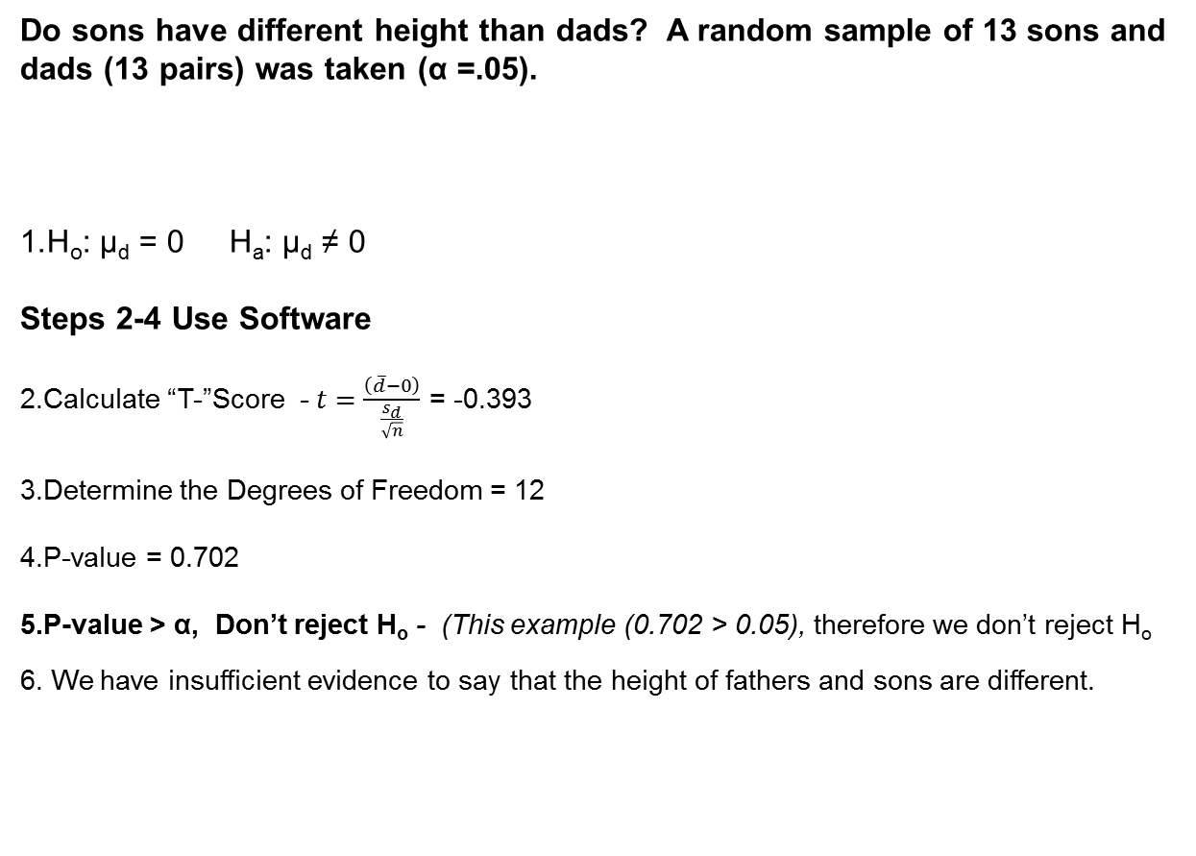
Matched-Pair Design - (Example)
Do sons have different height than dads? A random sample of 13 sons and dads (13 pairs) was taken (α =.05).
H_{o}: µ_{d} = 0 H_{a}: µ_{d} ≠ 0
Steps 2-4 Use Software
Calculate “T-”Score - $t=\frac{\left(\overline{d}−0\right)}{\frac{s_{d}}{\sqrt{n}}}$ = -0.393
Determine the Degrees of Freedom = 12
P-value = 0.702
P-value > α, Don’t reject H_{o} - (This example (0.702 > 0.05), therefore we don’t reject H_{o}
We have insufficient evidence to say that the height of fathers and sons are different.

Slide 9

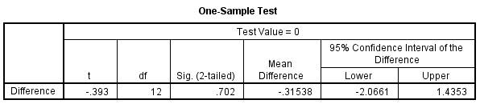
Test of Hypothesis (Example)
Standard Deviation of the Differences
Mean of the Differences
Step 2 - Test Statistic
Step 3- Degrees of Freedom
Step 4 P-value

Slide 10
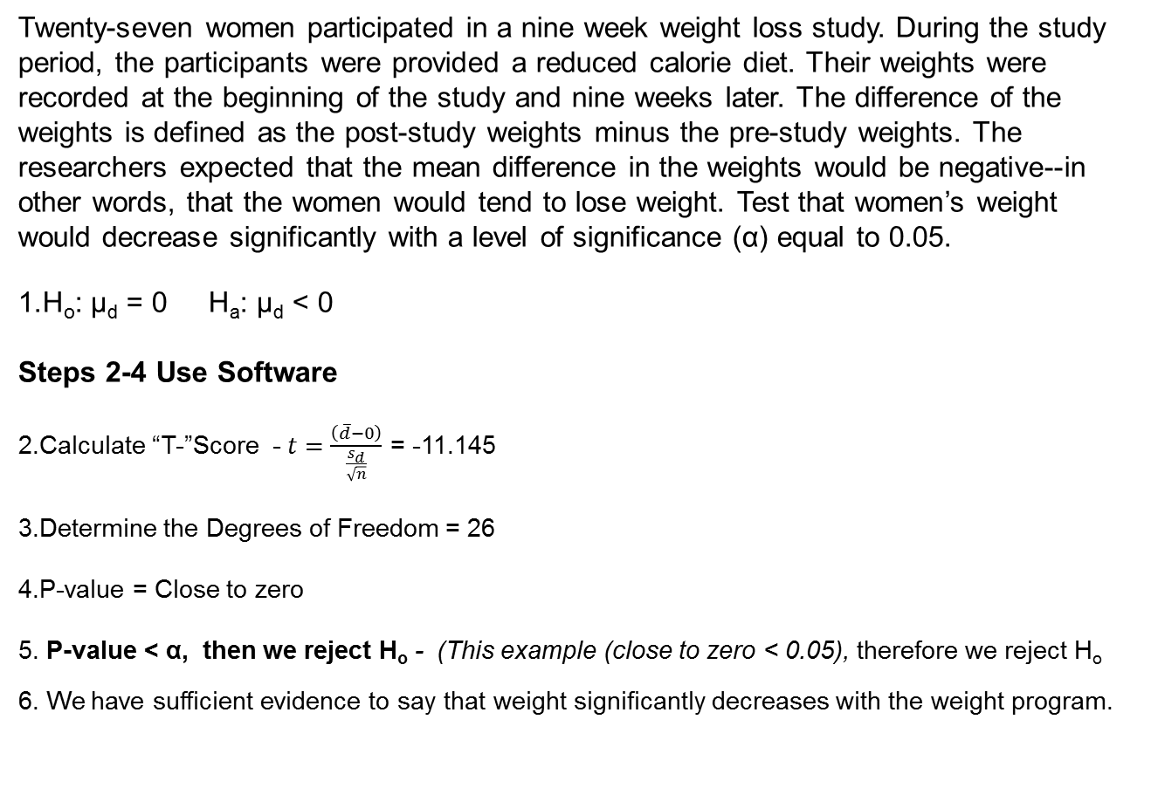
Matched-Pair Design - (Example 2)
Twenty-seven women participated in a nine week weight loss study. During the study period, the participants were provided a reduced calorie diet. Their weights were recorded at the beginning of the study and nine weeks later. The difference of the weights is defined as the post-study weights minus the pre-study weights. The researchers expected that the mean difference in the weights would be negative--in other words, that the women would tend to lose weight. Test that women’s weight would decrease significantly with a level of significance (α) equal to 0.05.
H_{o}: µ_{d} = 0 H_{a}: µ_{d} < 0
Steps 2-4 Use Software
Calculate “T-”Score - $t=\frac{\left(\overline{d}−0\right)}{\frac{s_{d}}{\sqrt{n}}}$ = -11.145
Determine the Degrees of Freedom = 26
P-value = Close to zero
P-value < α, then we reject H_{o} - (This example (close to zero < 0.05), therefore we reject H_{o}
We have sufficient evidence to say that weight significantly decreases with the weight program.

Slide 11
Inference for Two Means: Paired Data
Intro to Matched Pairs
Hypothesis Testing
Confidence Intervals
Checking Requirements

Slide 12
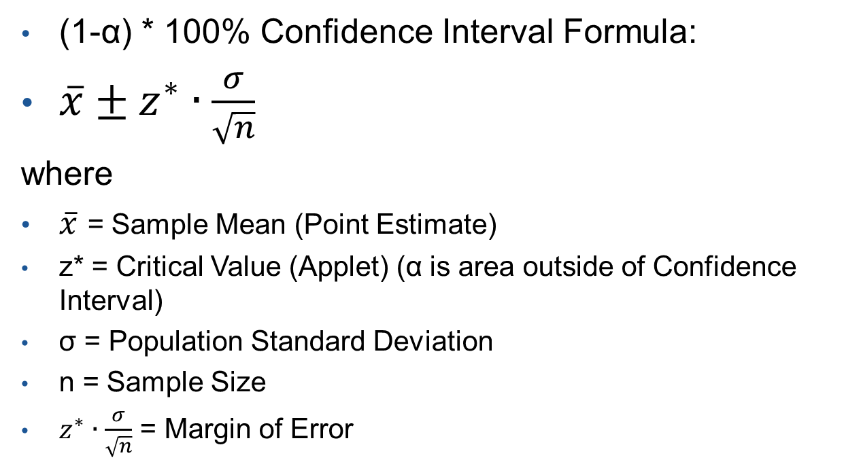
Confidence Interval (σ known)
(1-α) * 100% Confidence Interval Formula:
$\overline{x}±z^{∗}∙\frac{σ}{\sqrt{n}}$
where
$\overline{x}$ = Sample Mean (Point Estimate)
z* = Critical Value (Applet) (α is area outside of Confidence Interval)
σ = Population Standard Deviation
n = Sample Size
$z^{∗}∙\frac{σ}{\sqrt{n}}$ = Margin of Error
How realistic is the σ being known?

Slide 13
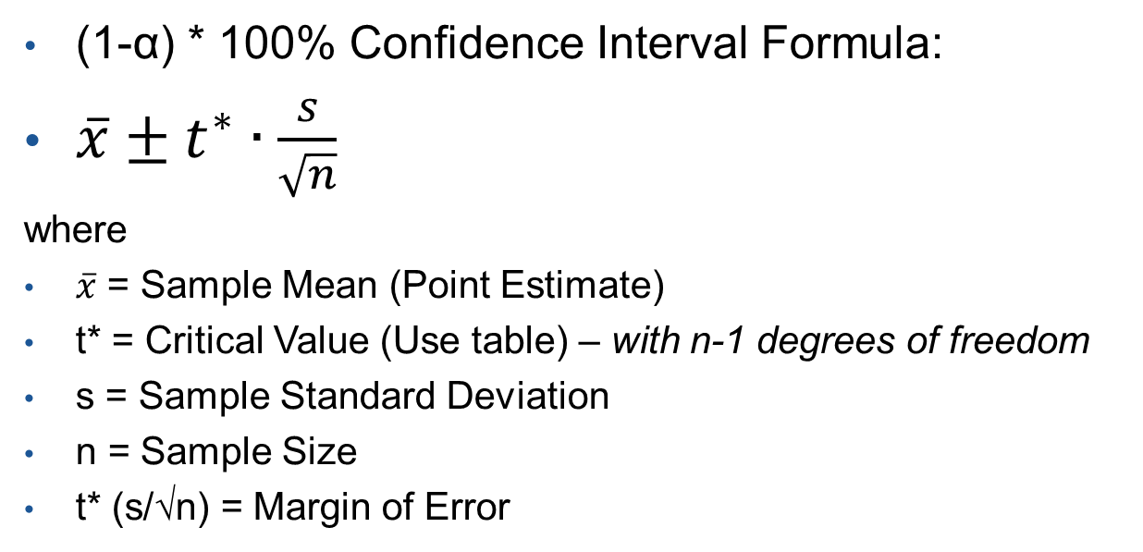
Confidence Interval (σ unknown)
(1-α) * 100% Confidence Interval Formula:
$\overline{x}±t^{∗}∙\frac{s}{\sqrt{n}}$
where
$\overline{x}$ = Sample Mean (Point Estimate)
t* = Critical Value (Use table) – with n-1 degrees of freedom
s = Sample Standard Deviation
n = Sample Size
t* (s/√n) = Margin of Error

Slide 14
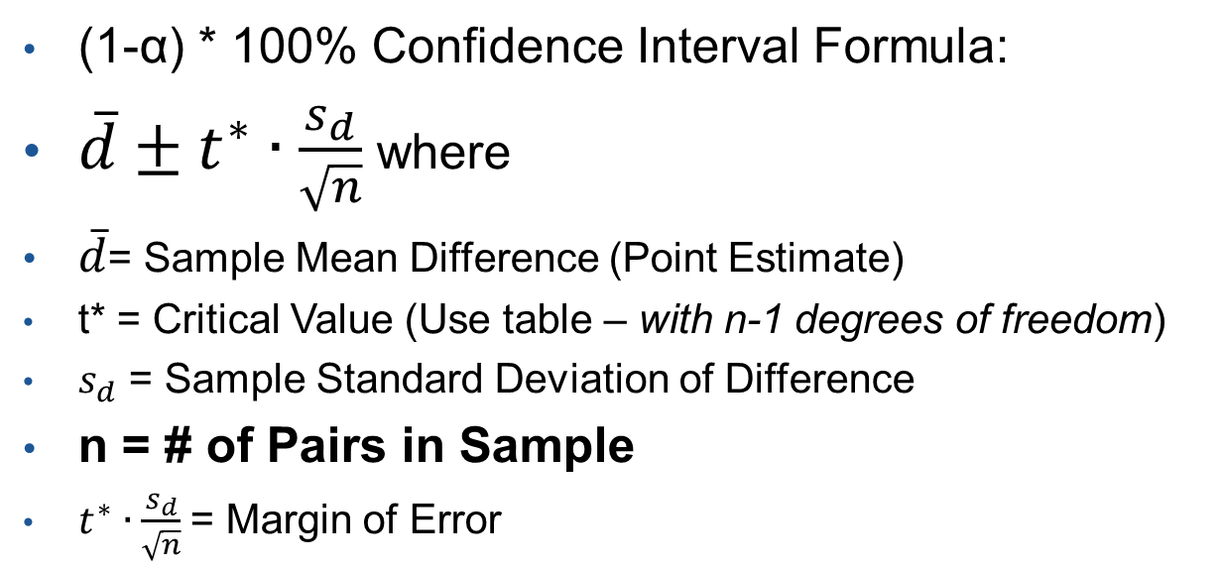
Confidence Interval (Matched-Pairs)
(1-α) * 100% Confidence Interval Formula:
$\overline{d}±t^{∗}∙\frac{s_{d}}{\sqrt{n}}$where
$\overline{d}$= Sample Mean Difference (Point Estimate)
t* = Critical Value (Use table – with n-1 degrees of freedom)
$s_{d}$ = Sample Standard Deviation of Difference
n = # of Pairs in Sample
$t^{∗}∙\frac{s_{d}}{\sqrt{n}}$= Margin of Error

Slide 15
Confidence Interval (Example)
Standard Deviation of the Differences
Mean of the Differences
Degrees of Freedom
Interpret - We are 95% confident that the mean of the differences is between -2.06 and 1.44
Zero is in the confidence interval, we cannot tell if there is a mean difference in height between fathers and sons.

Slide 16
Confidence Interval (Example)
Twenty-seven women participated in a nine week weight loss study. During the study period, the participants were provided a reduced calorie diet. Their weights were recorded at the beginning of the study and nine weeks later. The difference of the weights is defined as the post-study weights minus the pre-study weights. The researchers expected that the mean difference in the weights would be negative--in other words, that the women would tend to lose weight. Since you are a crackerjack statistician you would like to construct and 95% confidence interval on the mean difference between the post-study weight and pre-study weight.
95% Confidence Interval (-8.059, -5.549)
We are 95% confident that the mean difference in weight is between -8.059 and -5.549.
Since zero is not in our confidence interval, there does appear to be a mean difference in post-study vs pre-study weight.

Slide 17
Inference for Two Means: Paired Data
Intro to Matched Pairs
Hypothesis Testing
Confidence Intervals
Checking Requirements

Slide 18
Requirements to Check and Descriptive Statistics
Before Doing Confidence Interval with Data
Requirements to Check for Matched Paired t procedure
  The sample is a Simple Random Sample
  The sample data are matched pairs
  The differences are normally distributed (use Q-Q Plot) or n is large (n≥30 - guideline) where n is the number of pairs (Central Limit Theorem)
Descriptive Statistics to Use with Data
  Numerical – Sample Mean and Standard Deviation of the Differences
  Graphical – Histogram or Boxplot of the Differences

